Slide 1
OPENING A NEW RESTAURANT IN HYDERABAD, INDIA Name: Varija Reddy Sankapalli Date: 11/24/2020
IBM APPLIED DATA SCIENCE CAPSTONE PROJECT

Slide 2
Introduction
THE BATTLE OF NEIGHBORHOOD PROJECT
Hyderabad city is the sixth-most populous urban cluster in India. Western parts of the city have rapidly grown in the recent times, owing to IT and Service Sector while the eastern parts have become residential hubs while the central part forms the commercial, economic and cultural core of the city.
The people of India generally love food and I personally love to try different cuisines and experience different flavors.
The aim of this project is to study the neighborhoods in Hyderabad to determine possible locations for opening a restaurant.

Slide 3
Business Problem
The objective of this Capstone project is to analyze and select the best locations in the city of Hyderabad, India to open a new restaurant.
Using data science methodology and machine learning techniques like clustering, this project can be useful for business owners and entrepreneurs who are looking to invest in a restaurant in Hyderabad.
The main objective of this project is to carefully analyze appropriate data and find recommendations for the stakeholders.

Slide 4
Data Required
For this project, we need the following data:
Neighborhood Data: The data of the neighborhoods in Hyderabad was extracted from https://en.wikipedia.org/wiki/List_of_neighbourhoods_in_Hyderabad.
Geographical coordinates: The geographical coordinates of Hyderabad can be obtained from the GeoPy library in python. These coordinates are then further used for plotting using the Folium library in python.
Venue Data: The venue can be extracted using the Foursquare API.

Slide 5
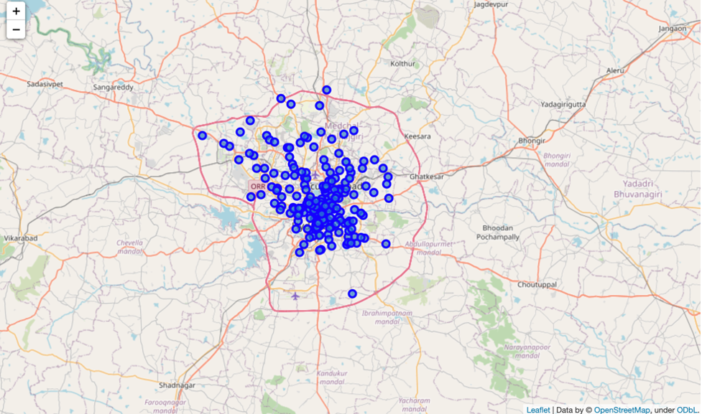
Hyderabad City Map
The blue circles represent different neighborhoods of Hyderabad city.
This map represents all the 200 nearby neighborhoods of Hyderabad, India.
We can use K-Means clustering machine learning technique to group all the neighborhoods into different clusters.

Slide 6
Methodology
Firstly, data is retrieved from https://en.wikipedia.org/wiki/List_of_neighbourhoods_in_Hyderabad to get the list of neighborhoods in Hyderabad, India.
Web scraping is done using Python requests and Beautiful Soup packages to extract the list of neighborhoods of Hyderabad.
Foursquare API is used to get the top venues that are within a radius of 1000 meters. API calls are made to Foursquare passing in the geographical coordinates of the neighborhoods in a Python loop.
Clustering neighborhoods of Hyderabad, India is done using K-Means Clustering. Here, I used Silhouette Score to determine how many clusters are needed to use for the required data .

Slide 7
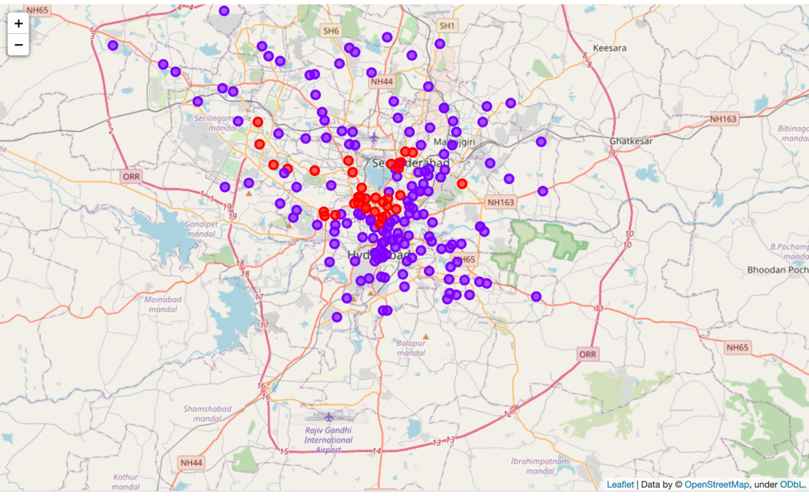
Results
The results from K-Means clustering show that the neighborhood is categorized into two clusters.
Cluster 0: Neighborhoods with less numbers of restaurants.
Cluster 1: Neighborhoods with a greater number of restaurants.
The results of Clustering are visualized in the map below with cluster 0 in red color, cluster 1 in purple color.

Slide 8
Discussions
By analyzing the two clusters obtained we can see that some of the clusters are more suited for restaurants and hotels, whereas other clusters are less suited.
Thus, it is recommended that the new restaurant can be opened in the neighborhoods belonging to cluster 1.

Slide 9
Limitations and Suggestions
This project was done only considering best place to open a new restaurant in Hyderabad, India.
There are also other factors such as population and income of residents that could influence the decision of selecting a place to open a new restaurant.
Future research may include a methodology to estimate such data to be used in clustering algorithm to determine the preferred locations to open a new restaurant in Hyderabad.
In addition, Sandbox Tier Account of Foursquare API is used here that has limitations to the number of API calls and results returned.
Future research may use paid account to overcome these limitations to get results.

Slide 10
Conclusion
We have successfully analyzed the neighborhoods in Hyderabad, India for determining which would be the best neighborhoods for opening a new restaurant.
Based on our analysis, neighborhoods in cluster 1 are recommended as locations for the new restaurant.
The stakeholders and investors can further tune this by considering various other factors like transport, legal requirements, and costs associated.

